Slide 1
Module 5: Integrating Intelligence Dashboards into Siebel Applications
Analytics: Application Developer (Siebel 7.7)
Notes:
Time: Lecture: 40 – 50 minutes; labs: 60 – 80 minutes
Intent: It is important that students understand that this module is not going to teach them how to use Tools. This module is to familiarize them with the steps that go into using symbolic URLs so that they can effectively communicate with the team members who will be responsible for the actual work in Tools and the appropriate Siebel applications.
Flow: The module covers the high-level steps for both inline and iFrame integrations. Students go through the detail steps in the labs.
Key Terms:
Inline
iFrame
Symbolic URL
5

Slide 2

Module Objectives
After completing this module you will be able to:
  Add analytics content to Siebel CRM applications using Siebel Tools and the symbolic URL infrastructure
Why you need to know:
  Dashboards can be displayed in other Siebel applications
Notes:
Each objective and “why you need to know” should be stated aloud.

Slide 3
Integrating Dashboards
Two types:
  Inline—adding a Siebel Analytics request within a Siebel applet
  iFrame—adding a dashboard as a Siebel view
Notes:
With a symbolic URL disposition type of Inline, the Siebel Server receives content sent by an external application. It combines the external content with Siebel-produced content and composes a single HTML page, which it then sends to the client browser for display to the user.
The IFrame disposition type uses the <iframe> tag to create an Internal Frame as part of the page generated by the Siebel Server. It allows the Portal Agent to retrieve content to populate the Internal Frame. This content does not pass through the Siebel Server, but is directly requested by the client and sent by the application server to the user's browser.
Basic rule of thumb: Use Inline for individual requests; use iFrame for entire dashboard pages.
5

Slide 4
Inline
0/7
Identify the view
Add a field to the AnalyticsSSO business component
Create a new applet
Associate the AnalyticsSSO BC to the view’s BO
Add the applet to the view
Find the path to the Analytics request
Create the symbolic URL
Notes:
This is a structuring slide. Do not teach the steps or concepts here because the following slides cover them in detail.
This general process will place a request in a Siebel application.
In the labs for this module students are required to navigate Siebel Tools. The labs are detailed with illustrative screenshots. Students should be able to complete the labs successfully even if they have no prior experience using Siebel Tools.
Also in the labs for this module, students navigate within the Siebel Call Center application. Again, the steps are detailed with screenshots. Students should be able to complete the labs successfully even if they have no prior experience using Siebel applications.

Slide 5
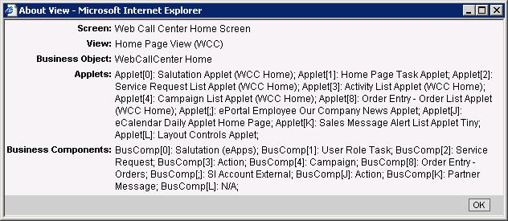
1. Identify the View
1/7
Use Help > About View in the Siebel Application to find the view name
  Used to identify the business object
View name
Identifies the business object
Notes:
You use this process to identify the objects to modify in Siebel Tools. Here we are identifying the business object and the view name by using the About View feature in a Siebel application.
5

Slide 6

2. Add a Field to the AnalyticsSSO Business Component
2/7
Using Tools, copy the existing field
1. Copy the HomePageAnalytics field
3. Rename the Calculated value to MyHomePageAnalytics
2. Rename to MyHomePageAnalytics
Notes:
The next step is to open Siebel Tools and add a field to the Analytics SSO business component. SSO stands for Single Sign On. For applications that are participating in a Single Sign On framework, this feature eliminates the need for the user to enter login credentials, such as username and password, more than once per work session. This step allows an Analytics request to use the SSO feature.

Slide 7
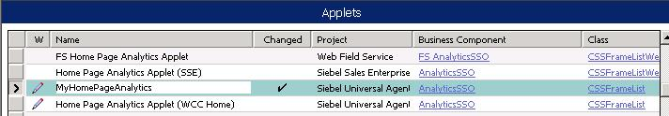

3. Create a New Applet
3/7
Query for the *Home Page Analytics* applet and copy record
Name the new applet MyHomePageAnalytics
Drill down and rename the associated List Column field and name
Notes:
The next step is to create a new applet in Siebel Tools. The applet will get the Analytics request from the Analytics server.
5

Slide 8
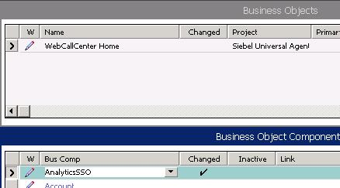
4. Associate the AnalyticsSSO BC to the View’s BO
4/7
Use the view you determined in step 1 to find the business object
1. Determine the business object
2. Click link to drill down
3. Add the AnalyticsSSO business component, if necessary
Notes:
This step connects the applet created in the previous step to the view that will display the results of the Analytics request.

Slide 9
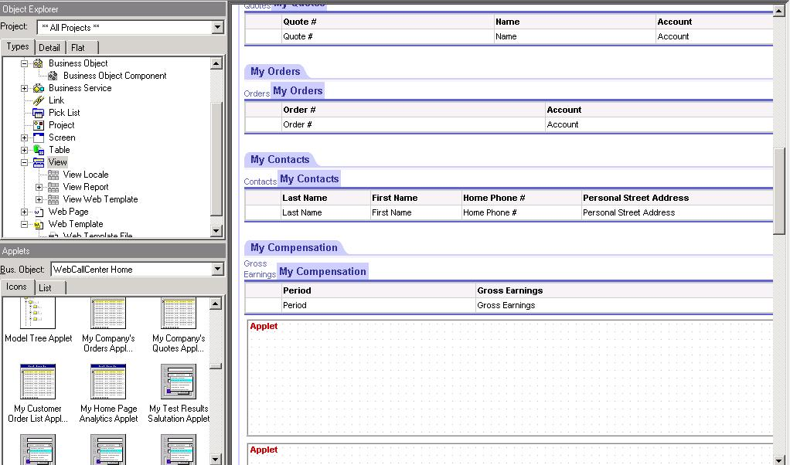
5. Add the Applet to the View
5/7
Click and drag the My Home Page Analytics applet to a free applet placeholder in the view
Notes:
This step physically locates where in the view’s Web template the Analytics request will display.
5

Slide 10
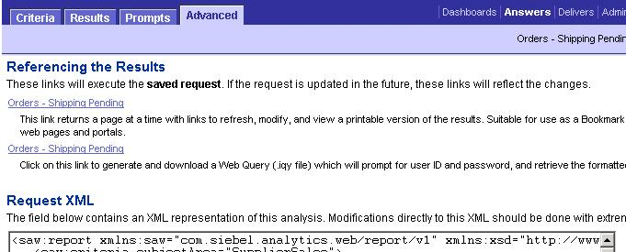
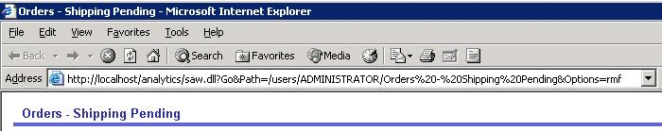
6. Find the Path to the Analytics Request
6/7
In Answers, select the request, then the Advanced tab
Click this link
Copy the URL after the Go&Path=
Notes:
The next step is to use Siebel Answers to identify the path to the Analytics request that you want to embed. This is part of defining the Symbolic URL, which is discussed in detail on the next slide. As a part of creating the Symbolic URL, the path to the individual Analytics request needs to be determined.

Slide 11
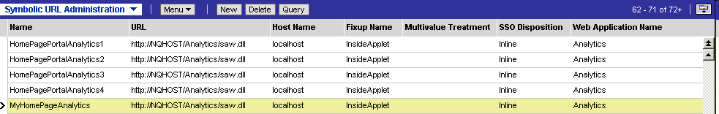
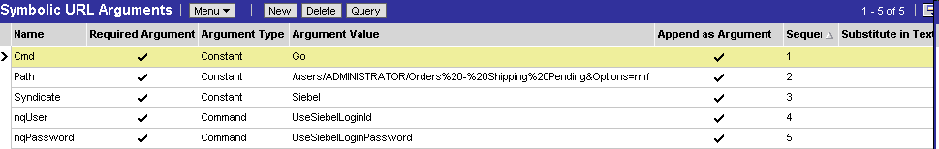
7. Create the Symbolic URL
7/7
Navigate to Integration Administration - Integration > Symbolic URL Administration
Create new symbolic URL
Add arguments
Notes:
This step completes the Symbolic URL configuration inside the Siebel application. This value specifies that the content will come from an external host (in this case, the Analytics server) based on a symbolic URL. You need to define the necessary information needed to access the external source. This includes the syntax used for the request, the host name, necessary arguments, and so on.
5

Slide 12
7. Create the Symbolic URL Continued
7/7
Argument values for the Symbolic URL:
Name | Required Argument | Argument Type | Argument Value | Sequence ID
Cmd | Yes | Constant | Go | 1
Path | Yes | Constant | path determined in step 6 | 2
Syndicate | Yes | Constant | Siebel | 3
nqUser | Yes | Command | UseSiebelLoginid | 4
nqPassword | Yes | Command | UseSiebelLoginPassword | 5
Notes:
This tables contains the arguments for the Symbolic URL necessary for displaying an Analytics request inline.

Slide 13
iFrame
0/7
Add a field to the AnalyticsSSO business component
Create a new applet
Create an Analytics Dashboard view
Create an Analytics Dashboard screen
Add the view to the Siebel application
Find the path to the request
Create the symbolic URL
Notes:
This is a structuring slide. Do not teach the steps or concepts here because the following slides cover them in detail.
You may want to review Inline versus iFrame again before starting the iFrame process.
5

Slide 14

1. Add a Field to the AnalyticsSSO Business Component
1/7
Using Tools, copy the existing field
2. Rename the Calculated value
1. Copy the HomePageAnalytics field
Notes:
Similar to inline, the first step is to add a field to the Analytics SSO business component in Siebel Tools.

Slide 15

2. Create a New Applet
2/7
Query for the SSO Executive Dashboard Applet and copy
Notes:
The next step is to create a new applet. There are pre-existing dashboard applets that can be used for new dashboards by copying and reconfiguring. In this example, the SSO Executive Dashboard applet is copied and renamed to My SSO Dashboard Applet.
5

Slide 16

3. Create an Analytics Dashboard View
3/7
Create a new view for each dashboard to add to the application
Notes:
The next step is to create a new view for the dashboard that will be added to the Siebel Call Center application. In this example, the Executive Dashboard View is copied and renamed to My New Dashboard view.

Slide 17
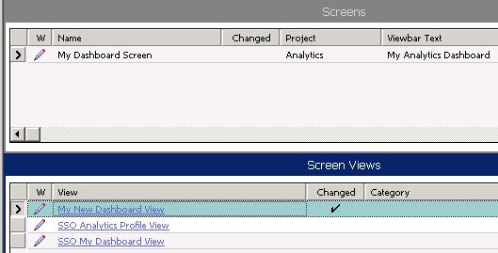
4. Create an Analytics Dashboard Screen
4/7
Associate the view created in the previous step to an existing screen or create a new screen and add the view
Notes:
The next step is to add the view created in the previous step to an existing screen, or create a new screen and add the view. The screen is the highest level UI element in a Siebel application and needs to be configured for new dashboards. Once all the object definitions have been created, the Siebel repository file (.srf) must be compiled. The step is not shown here, but students compile the .srf in the labs.
5

Slide 18

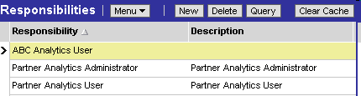
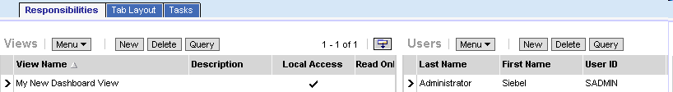
5. Add the View to the Siebel Application
5/7
In the Siebel Application, navigate to Administration - Application
1. Create the view
2. Create a new responsibility
4. Add users
3. Add the view
Notes:
In order for users to see the views, the views must be added to the user's responsibility. Students may be unfamiliar with Siebel security. Be prepared to answer questions about the relationship between views, users, and responsibilities.

Slide 19
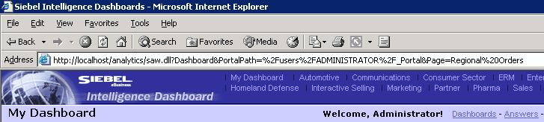
6. Find the Path to the Request
6/7
In Answers, navigate to the dashboard
Path
%2F = /
%20 = space
Notes:
As a part of creating the Symbolic URL, the path to the individual Analytics dashboard needs to be determined. There are a couple of methods for determining the path. One is illustrated here. Another is illustrated in the lab.
5

Slide 20

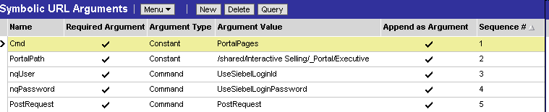
7. Create the Symbolic URL
7/7
Navigate to Integration Administration - Integration > Symbolic URL Administration
Create new symbolic URL
Add arguments
Notes:
The next step is to define the symbolic URL arguments in the Siebel application. The argument values are identified on the next slide.

Slide 21
7. Create the Symbolic URL Continued
7/7
Argument values for the Symbolic URL:
Name | Required Argument | Argument Type | Argument Value | Sequence ID
Cmd | Yes | Constant | PortalPages | 1
Path | Yes | Constant | path determined in step 6 | 2
nqUser | Yes | Command | UseSiebelLoginid | 3
nqPassword | Yes | Command | UseSiebelLoginPassword | 4
PostRequest | Yes | Command | PostRequest | 5
Notes:
Point out that the arguments, while similar, are not identical to Inline.
5

Slide 22
Summary
This module showed you how to:
  Add analytics content to Siebel CRM applications using Siebel Tools and the symbolic URL infrastructure
Notes:
Review Questions
Question: Which symbolic URL type would you use to integrate a dashboard into a Siebel application?
Answer: iFrame
Review Question: Which symbolic URL type would you use to integrate a request into a Siebel application?
Answer: Inline

Slide 23
Lab
In the lab you will:
  Add a Siebel Analytics request within a Siebel applet
  Add a dashboard as a Siebel view
Notes:
Labs and Troubleshooting:
Labs and Troubleshooting:
These labs may be tricky for some students because they may not have prior experience using Siebel Tools. Emphasize that care must be taken to follow each step carefully and that values should be entered exactly as shown in the lab.
ERROR: Between the release of the course and the writing of this instructor guide, an error was detected for these labs. Before beginning these labs students must set the NQHOST parameter to localhost. Students do perform this step in the prerequisite Analytics: Overview course. If Application Developer is run immediately after the Overview course, without refreshing the image, NQHOST will already be set to localhost. But if Application Developer is run on its own, have students follow these instructions to set this parameter before starting the labs:
1. Log in to Siebel Call Center as SADMIN connected to Server database.
2. Select Site Map > Administration – Integration > WI Symbolic URL List > Host Administration.
3. Locate Virtual Name = NQHOST
4. Change the Name field to localhost. Be sure to change the Name field and not the Virtual Name field.
If students have trouble with the labs and do not get the expected results, the siebel.srf solution file can be used to catch up students:
1. Close the Siebel application, if open.
2. Rename C:\SUsea\client\OBJECTS\ENU\siebel.srf to siebel.srf_old.
3. Copy the siebel.srf_AfterModule05 solution file and paste into C:\SUsea\client\OBJECTS\ENU.
4. Rename siebel.srf_AfterModule05 to siebel.srf.
5. Update the webcat file for Module 5 using the procedure outlined in the instructor notes for the last slide in Module 1.
6. Open the Siebel application and verify that the Analytics objects appear as expected.
5

